Slide 1
Discrete Mathematics and Its Application 7th edition, 2001
Kenneth H. Rosen

Slide 2
Welcome to Discrete Mathematics Spring 2018
Instructor: Niu Shao Zhang

Slide 3
§6.5 Generalized Permutations and Combinations
Section Summary
Permutations with Repetition
Combinations with Repetition
Permutations with Indistinguishable Objects
Distributing Objects into Boxes

Slide 4
Permutations with Repetition
Theorem 1: The number of r-permutations of a set of n objects with repetition allowed is n^{r}.
Proof: There are n ways to select an element of the set for each of the r positions in the r-permutation when repetition is allowed. Hence, by the product rule there are n^{r} r-permutations with repetition.

Slide 5
Permutations with Repetition
Example: How many strings of length r can be formed from the uppercase letters of the English alphabet?
Solution: The number of such strings is 26^{r}, which is the number of r-permutations of a set with 26 elements.

Slide 6
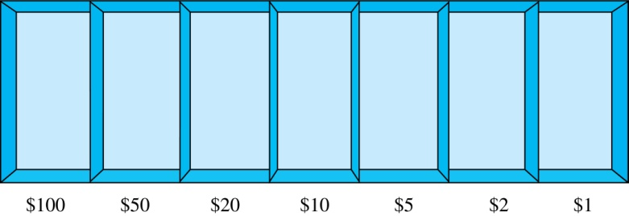
Combinations with Repetition
Example: How many ways are there to select five bills from a box containing at least five of each of the following denominations: $1, $2, $5, $10, $20, $50, and $100?
Solution: Place the selected bills in the appropriate position of a cash box illustrated below:

Slide 7
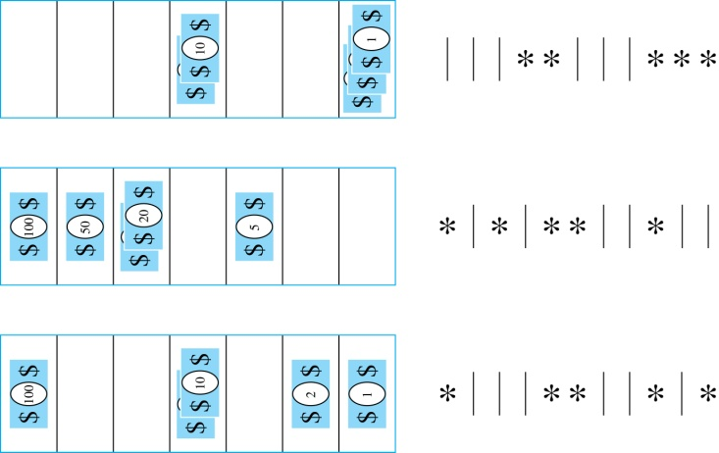

Combinations with Repetition
Some possible ways of
placing the five bills:
The number of ways to select five bills corresponds to the number of ways to arrange six bars and five stars in a row.
This is the number of unordered selections of 5 objects from a set of 11. Hence, there are
ways to choose five bills with seven types of bills.

Slide 8
Combinations with Repetition
Theorem 2: The number of r-combinations from a set with n elements when repetition of elements is allowed is
C(n + r – 1,r) = C(n + r – 1, n –1).
Proof: Each r-combination of a set with n elements with repetition allowed can be represented by a list of n –1 bars and r stars. The bars mark the n cells containing a star for each time the ith element of the set occurs in the combination.
The number of such lists is C(n + r – 1, r), because each list is a choice of the r positions to place the stars, from the total of n + r – 1 positions to place the stars and the bars. This is also equal to C(n + r – 1, n –1), which is the number of ways to place the n –1 bars.

Slide 9
Combinations with Repetition
Example: How many solutions does the equation
x₁ + x₂ + x₃ = 11
have, where x₁ , x₂ and x₃ are nonnegative integers?
Solution: Each solution corresponds to a way to select 11 items from a set with three elements; x₁ elements of type one, x₂ of type two, and x₃ of type three.
By Theorem 2 it follows that there are
solutions.

Slide 10
Example 5
How many solutions does the equation x₁+x₂+x₃=11 have, where x₁, x₂, and x₃ are nonnegative integers?
x₁≥1, x₂≥2, x₃≥3.
(x₁-1)+(x₂-2)+(x₃-3)=5
a choice of ﬁve additional items of any type.
C(3+5-1,5)=C(7,5)=C(7,2)=7*6/2=21

Slide 11
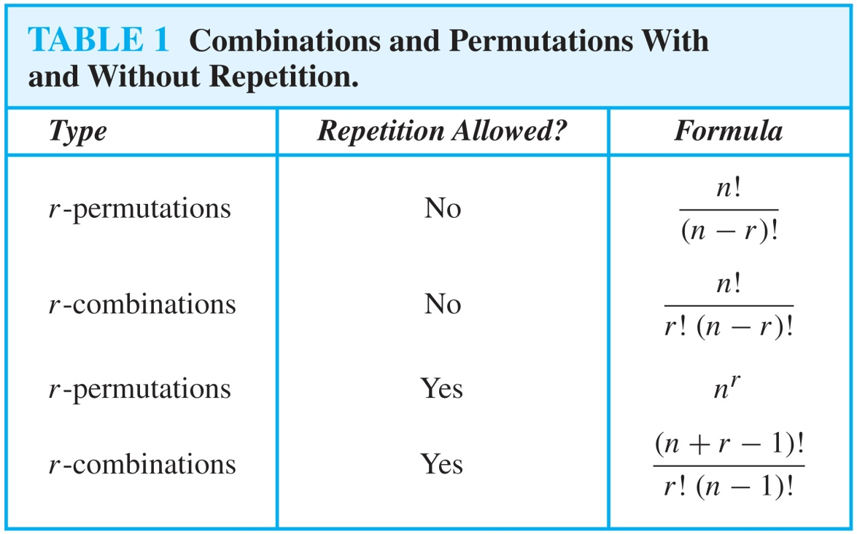
Summarizing the Formulas for Counting Permutations and Combinations with and without Repetition

Slide 12
Permutations with Indistinguishable Objects
Example: How many different strings can be made by reordering the letters of the word SUCCESS.
Solution: There are seven possible positions for the three Ss, two Cs, one U, and one E.
The three Ss can be placed in C(7,3) different ways, leaving four positions free.
The two Cs can be placed in C(4,2) different ways, leaving two positions free.
The U can be placed in C(2,1) different ways, leaving one position free.
The E can be placed in C(1,1) way.

Slide 13
Permutations with Indistinguishable Objects
Theorem 3
The number of different permutations of n objects, where there are n_{l} indistinguishable objects of type 1, n₂ indistinguishable objects of type 2,…and n_{k} indistinguishable objects of type k, is

Slide 14
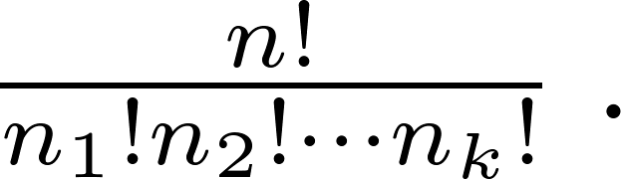
Permutations with Indistinguishable Objects
Theorem 3: The number of different permutations of n objects, where there are n₁ indistinguishable objects of type 1, n₂ indistinguishable objects of type 2, …., and n_{k} indistinguishable objects of type k, is:
Proof: By the product rule the total number of permutations is:
C(n, n₁ ) C(n − n₁, n₂ ) ∙∙∙ C(n − n₁ − n₂ − ∙∙∙ − n_{k}, n_{k}) since:
The n₁ objects of type one can be placed in the n positions in C(n, n₁ ) ways, leaving n − n₁ positions.
Then the n₂ objects of type two can be placed in the n − n₁ positions in C(n − n₁, n₂ ) ways, leaving n − n₁ − n₂ positions.
Continue in this fashion, until n_{k} objects of type k are placed in C(n − n₁ − n₂ − ∙∙∙ − n_{k}, n_{k}) ways.
The product can be manipulated into the desired result as follows:

Slide 15
Distributing Objects into Boxes
Many counting problems can be solved by counting the ways objects can be placed in boxes.
The objects may be either different from each other (distinguishable) or identical (indistinguishable).
The boxes may be labeled (distinguishable) or unlabeled (indistinguishable).
(可以分为4种情况)

Slide 16
Distributing Objects into Boxes
Distinguishable objects and distinguishable boxes.
There are n!/(n₁!n₂! ∙∙∙n_{k}!) ways to distribute n distinguishable objects into k distinguishable boxes.
(See Exercises 47 and 48 for two different proofs.)

Slide 17
Distributing Objects into Boxes
Example 8
How many ways are there to distribute hands of 5 cards to each of four players from the standard deck of 52 cards?
Solution:
There are 52!/(5!5!5!5!32!) ways to distribute hands of 5 cards each to four players.

Slide 18
Distinguishable objects and distinguishable boxes
Theorem 4
The number of ways to distribute n distinguishable objects into k distinguishable boxes so that n_{i} objects are placed into box i,i=1,2,…k, equals

Slide 19
Distributing Objects into Boxes
Indistinguishable objects and distinguishable boxes.
There are C(n + r − 1, n − 1) ways to place r indistinguishable objects into n distinguishable boxes.
Proof based on one-to-one correspondence between n-combinations from a set with k-elements when repetition is allowed and the ways to place n indistinguishable objects into k distinguishable boxes.

Slide 20
Indistinguishable objects and distinguishable boxes.
Example 9
How many ways are there to place 10 indistinguishable balls into 8 distinguishable bins（箱子）?
There are C(n + r − 1, n − 1) ways to place r indistinguishable objects into n distinguishable boxes.
C(8 + 10 − 1, 10) = C(17,10) = 19,448

Slide 21
indistinguishable boxes
Distinguishable objects and indistinguishable boxes.
Example: There are 14 ways to put four employees into three indistinguishable offices (see Example 10).
There is no simple closed formula for the number of ways to distribute n distinguishable objects into j indistinguishable boxes.
See the text for a formula involving Stirling numbers of the second kind.
Indistinguishable objects and indistinguishable boxes.
Example: There are 9 ways to pack six copies of the same book into four identical boxes (see Example 11).
The number of ways of distributing n indistinguishable objects into k indistinguishable boxes equals p_{k}(n), the number of ways to write n as the sum of at most k positive integers in increasing order.
No simple closed formula exists for this number.

Slide 22
Homework
§6.5
14, 20, 34, 46

Slide 23
§6.6 Generating Perms. & Combs.
We will go over algorithms for:
Generating the next largest permutation, in lexicographic order.
Generating the next largest bit string.
Remember, a bit string can represent a combination.
Generating the next r-combination in lexicographic order.
Also we’ll give recursive algorithms for generating permutations, combinations, and r-combinations.

Slide 24
Generating All Permutations
procedure genAllPerms(n>0: integer) {output all permutations of the integers 1,..,n, in order from smallest to largest} for i:=1 to n begin used_{i} = F end {none of the integers have been used yet} recursiveGenPerms(i,n)
The recursiveGenPerms procedure is on the next slide…

Slide 25
Recursive Permutation Generator
procedure recursiveGenPerms(i,n) if i>n then begin {We’re done, print the answer.} for k := 1 to n print perm_{k} ; print newline end else
for j := 1 to n {Consider all poss. next items.} if ¬used_{j} then begin {Choose item j.} used_{j} := T; perm_{i} := j recursiveGenPerms(i+1,n) used_{j} := F {Now back up} end

Slide 26
Next Permutation in Order
Given an existing permutation a₁,…,a_{n} of {1,…,n}, how do we find the next one?
Outline of procedure:
Find largest j such that a_{j} < a_{j+1}.
Find the smallest integer in a_{j+1},…,a_{n} that is greater than a_{j}. Put it in position j.
Sort the remaining integers in a_{j},…,a_{n} from smallest to largest. Put them at j+1 through n.

Slide 27
Next-Permutation Procedure
procedure nextPerm(a₁,…,a_{n}: perm. {1,…,n}) j:=n−1; while a_{j}>a_{j+1} and j>0 do j:= j−1 if j=0 then return {no more permutations} k:=n; while a_{j} > a_{k} do k:=k−1 swap(a_{j}, a_{k}); r:=n; s:=j+1 while r>s do begin swap(a_{r},a_{s}); r:=r−1; s:=s+1 end

Slide 28
Combination Generator
Suppose we want to generate all combinations of the elements of the set {1, …, n}.
Or any other set with n elements.
A combination is just a subset.
And, a subset of n items can be specified using a bit-string of length n.
Each bit says whether the item is in the subset.
Therefore, we can enumerate all combinations by enumerating all bit-strings of length n.

Slide 29
Recursive Bit-String Enumerator
procedure recEnumBitStrings(soFar,n) {enumerate all strings consisting of soFar concatenated with a bit-string of length n} if n=0 then begin print soFar; return end enumBitStrings(soFar·‘0’, n−1) enumBitStrings(soFar·‘1’, n−1)
procedure enumBitStrings(n∈N) recEnumBitStrings(ε, n) {soFar=empty str}

Slide 30
Generating the Next Bit String
Note that this is essentially just a binary increment (“add 1”) operation.
procedure nextBitString(b_{n−1}…b₀: bit string) i:=0; {start at right end of string} while b_{i} = 1 and i<n begin {trailing 1s} b_{i} := 0; i:=i+1 end {change to 0s} if i=n then return “no more” else begin b_{i} = 1; return b_{n-1}…b₀ end {chg. 0→1}

Slide 31
Generating r-combinations
How do we list all r-combinations of the set {1,…,n}?
Since the order of elements in a combination doesn’t matter, we can always list them from smallest to largest.
We can thus do it by enumerating the possible smallest items, then for each, enumerating the possible next-smallest items, etc.

Slide 32
A Recursive r-comb. Generator
procedure recEnumRCombs(min,j,r,n) if j>n then print comb₁,…,comb_{n}; return for i:=min to n−r+1 begin comb_{j} = i recEnumRCombs(i+1, j+1, r−1, n) end

Slide 33
Generating Next r-combination
procedure nextRComb({a₁,…,a_{r}}⊂{1,…,n} with a_{i}<a_{i+1}) {Find the last item that can be inc’d} i:=r; while a_{i} = n−r+i do i:=i−1 a_{i} := a_{i} + 1 {Increment it} for j := i+1 to r {Set remaining items} a_{j} := a_{i} + j − i {to the subsequent #’s} return {a₁,…,a_{r}}

Slide 34
No Homework

